Slide 1
CSE/T/324A Computer Networks Topic 7- Network Layer Internet Protocol
Sarbani Roy
sarbani.roy@jadavpuruniversity.in
Office: CC-5-7
Cell: 9051639328

Slide 2
Some basics
The term internet is short for “internetworking”
interconnection of networks with different network access mechanisms, addressing, different routing techniques, etc.
An internet
Collection of communications networks interconnected by layer 3 switches and/or routers
The Internet - note the uppercase I
The global collection of individual machines and networks
IP (Internet Protocol)
most widely used internetworking protocol
foundation of all internet-based applications

Slide 3
Internetworking
Internetworking: connecting networks together to make an internetwork or an internet.
Need for Network Layer
Internet as a Datagram Network
Internet as a Connectionless Network

Slide 4
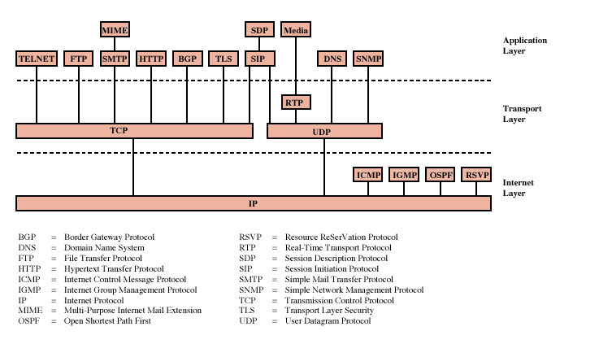
Protocols of TCP/IP Protocol Suite

Slide 5
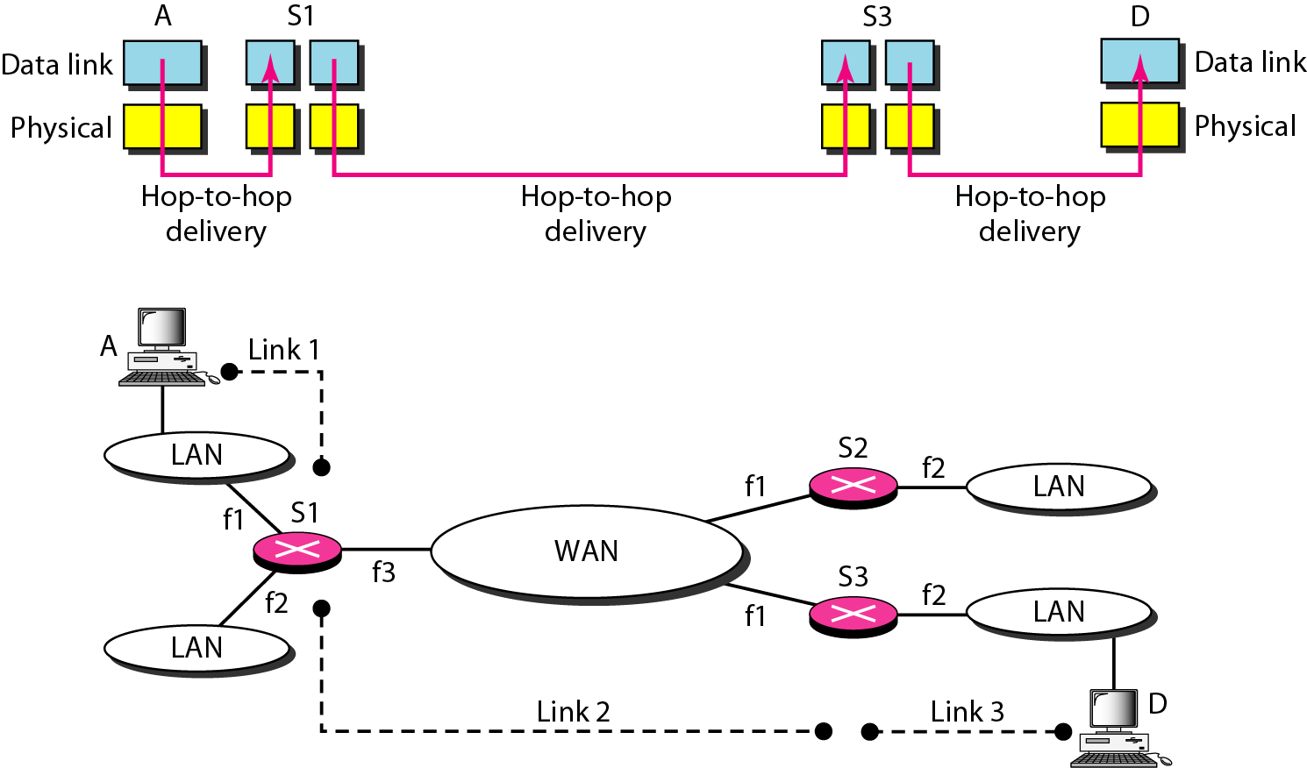
Hop-to-hop Delivery
The physical and data link layer of a network operate locally. These two layers are jointly responsible for data delivery on the network from one node to the next.

Slide 6
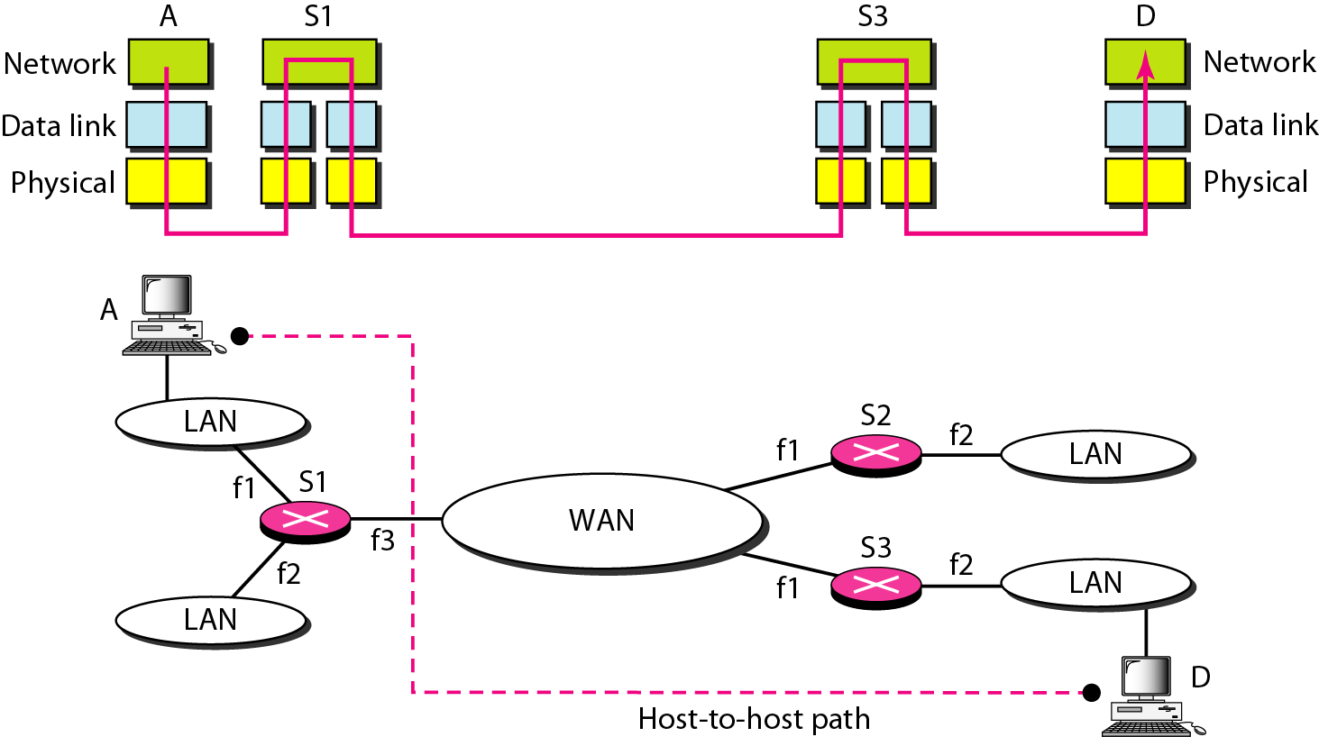
Host-to host delivery
The network layer is responsible for host-to-host delivery and for routing the packets through the routers or switches.

Slide 7
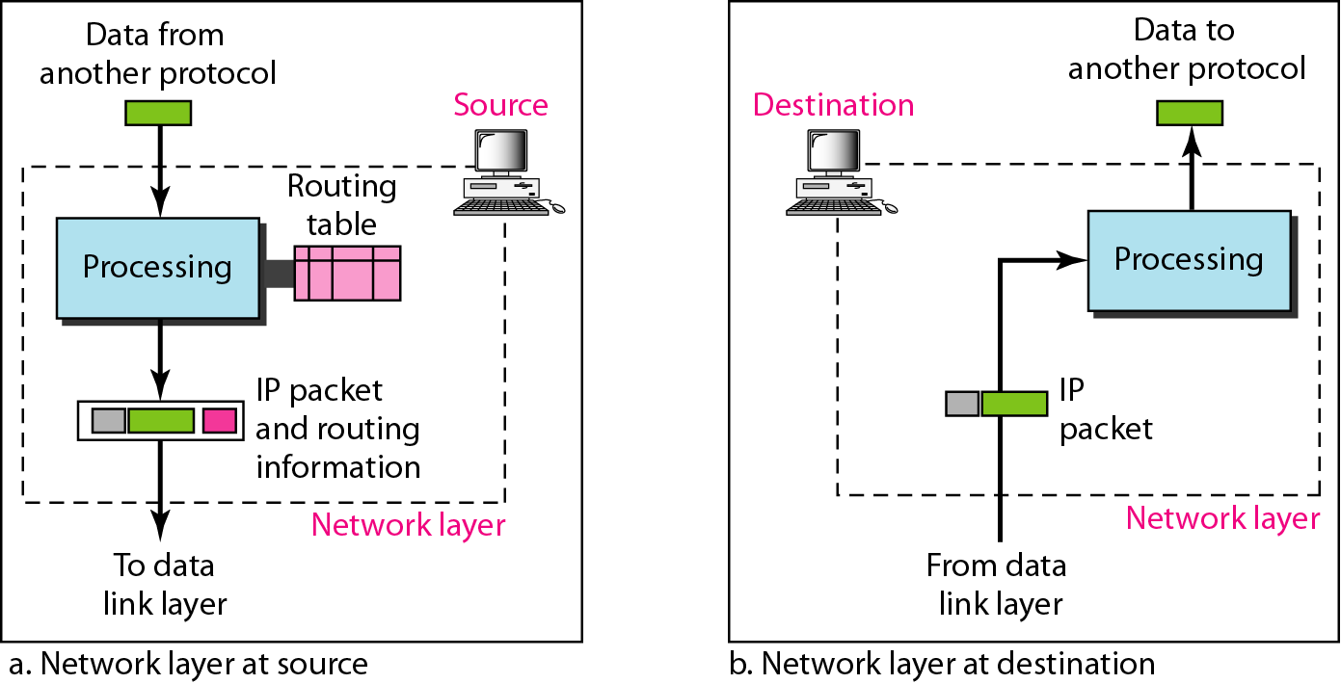
Network Layer at source and destination

Slide 8
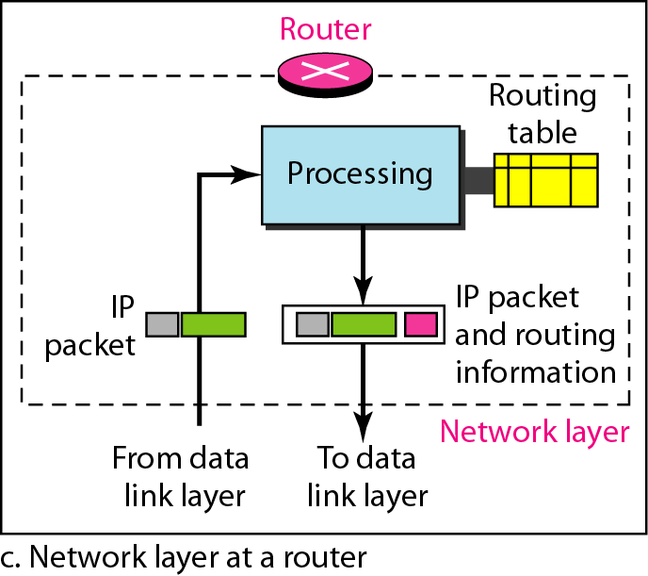
Network Layer at Router

Slide 9
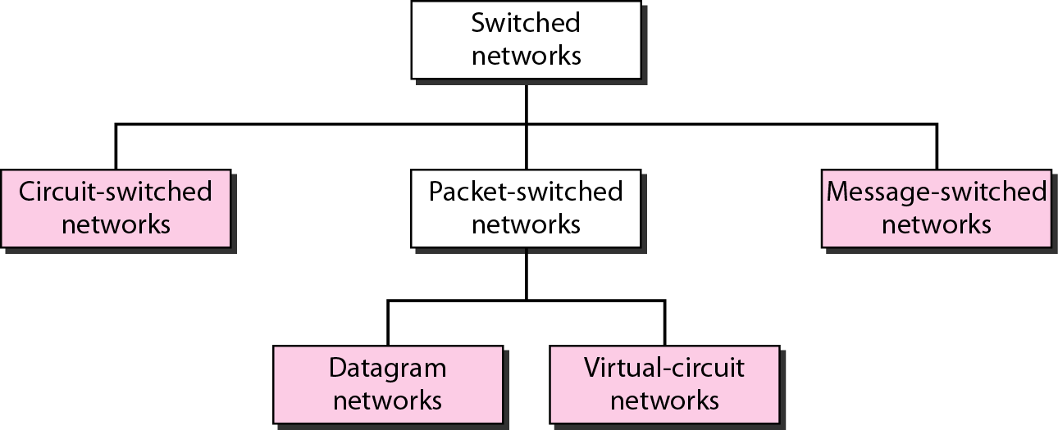
Switched Network
In data communications, we need to send messages from one end system to another. If the message is going to pass through a packet-switched network, it needs to be divided into packets of fixed or variable size. The size of the packet is determined by the network and the governing protocol.

Slide 10
Internet Protocol (IP)
Switching in the Internet is done by using the datagram approach to packet switching at the network layer.
IP provides connectionless (datagram) service
Each packet treated separately
Network layer protocol common to all routers
which is the Internet Protocol (IP)

Slide 11
Connectionless Internetworking (General)
Advantages
Flexible and robust
e.g. in case of congestion or node failure, packets find their way easier than connection-oriented services
No unnecessary overhead for connection setup
Can work with different network types
does not demand too much services from the actual network
Disadvantage: Unreliable
Not guaranteed delivery
Not guaranteed order of delivery
Packets can take different routes
Reliability is responsibility of next layer up (e.g. TCP)

Slide 12
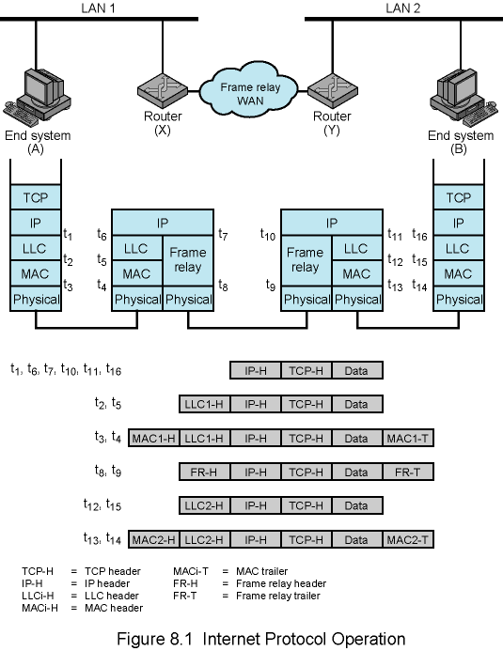
Example Internet Protocol Operation

Slide 13
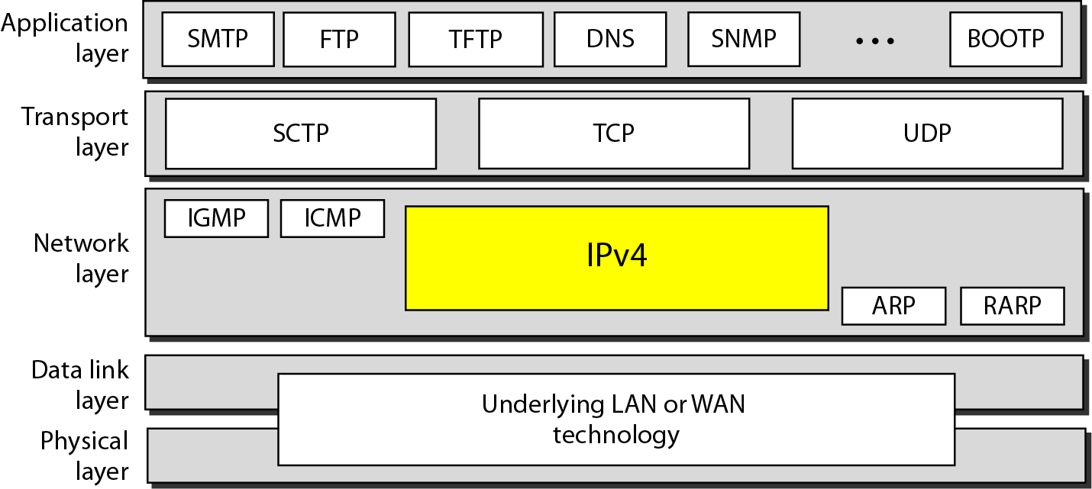
Position of IPv4 in TCP/IP protocol suite
The Internet Protocol version 4 (IPv4) is the delivery mechanism used by the TCP/IP protocols.

Slide 14
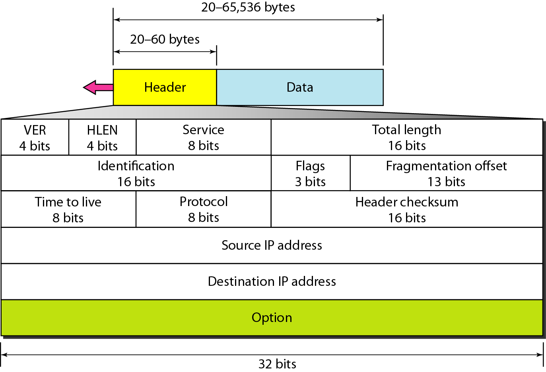
IPv4 Datagram format
Packets in the IPv4 layer are called datagrams

Slide 15
A datagram is a variable-length packet consisting of two parts: header and data. The header is 20 to 60 bytes in length and contains information essential to routing and delivery. It is customary in TCP/IP to show the header in 4-byte sections.

Slide 16
IP Service Model
Low-level communication model provided by Internet
Datagram
Each packet self-contained
All information needed to get to destination
No advance setup or connection maintenance
Analogous to letter or telegram
0
4
8
12
16
19
24
28
31
version
HLen
TOS
Length
IPv4 Packet
Format
Identifier
Flag
Offset
TTL
Protocol
Checksum
Header
Source Address
Destination Address
Options (if any)
Data

Slide 17
IPv4 Header Fields
Version: IP Version
4 for IPv4
HLen: Header Length
32-bit words (typically 5)
TOS: Type of Service
Priority information
0
4
8
12
16
19
24
28
31
ver-
sion
HLen
TOS
Length
Identifier
Flags
Offset
TTL
Protocol
Checksum
Source Address
Destination Address
Options (if any)
Data
Length: Packet Length
Bytes (including header)
The total length field defines the total length of the datagram including the header.
Header format can change with versions
First byte identifies version
Length field limits packets to 65,535 bytes
In practice, break into much smaller packets for network performance considerations

Slide 18
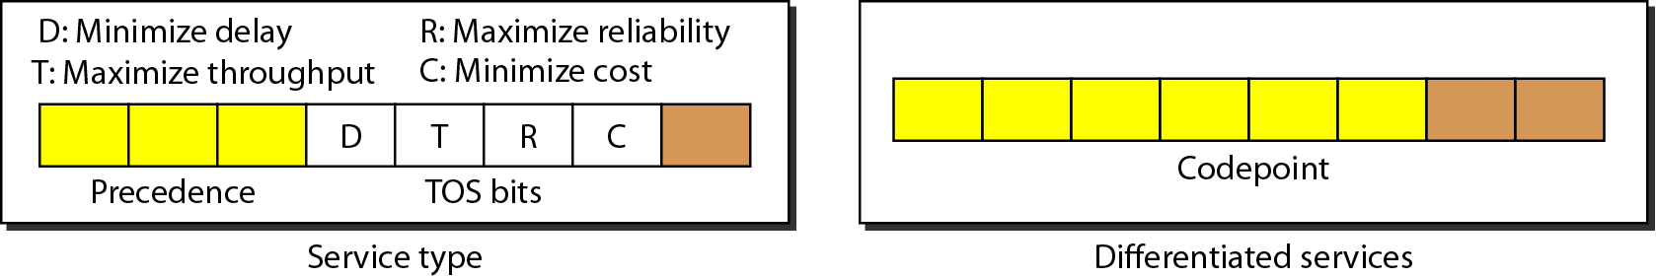
Type of Service

Slide 19
Types of service

Slide 20
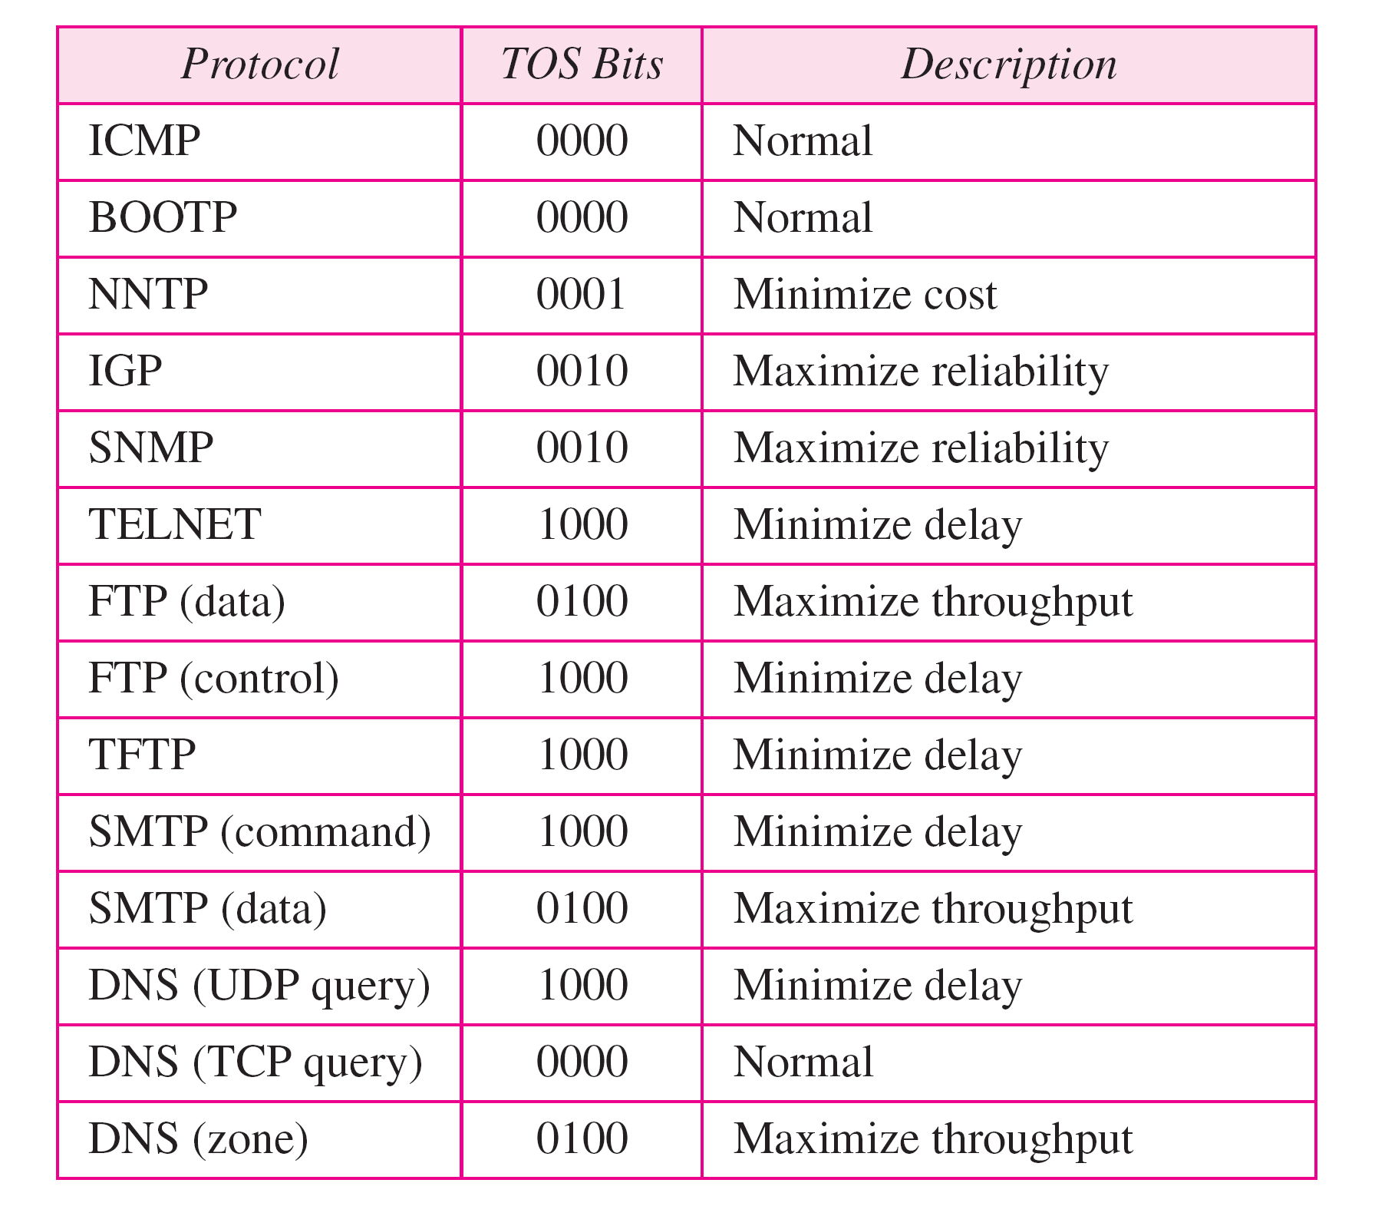
Default types of service

Slide 21
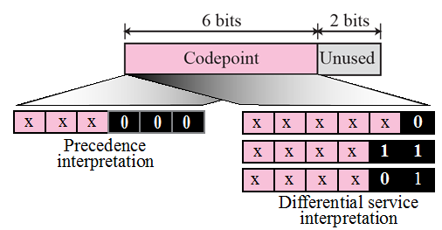
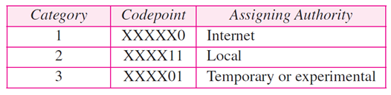
Codepoints

Slide 22
IPv4 Header Fields
Identifier, flags, fragment offset → used primarily for fragmentation
Time to live
Must be decremented at each router
Packets with TTL=0 are thrown away
Ensure packets exit the network
Protocol
Demultiplexing to higher layer protocols
TCP = 6, ICMP = 1, UDP = 17…
Header checksum
Ensures some degree of header integrity
Relatively weak – 16 bit
Options
E.g. Source routing, record route, etc.
Performance issues
Poorly supported
0
4
8
12
16
19
24
28
31
ver-
sion
HLen
TOS
Length
Identifier
Flags
Offset
TTL
Protocol
Checksum
Source Address
Destination Address
Options (if any)
Data

Slide 23
IPv4 Header Fields
0
4
8
12
16
19
24
28
31
Source Address
32-bit IP address of sender
Destination Address
32-bit IP address of destination
ver-
sion
HLen
TOS
Length
Identifier
Flags
Offset
TTL
Protocol
Checksum
Source Address
Destination Address
Options (if any)
Data
Like the addresses on an envelope
Globally unique identification of sender & receiver

Slide 24
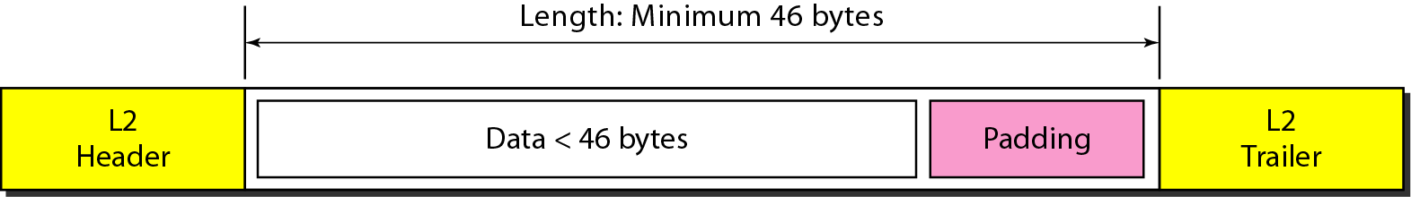
Encapsulation of a small datagram in an Ethernet frame

Slide 25
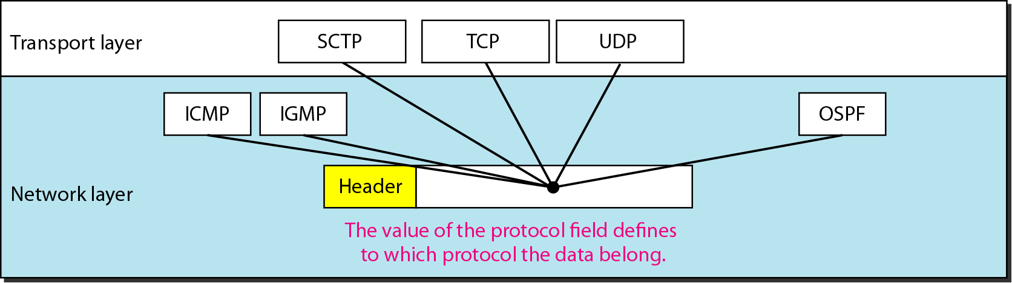
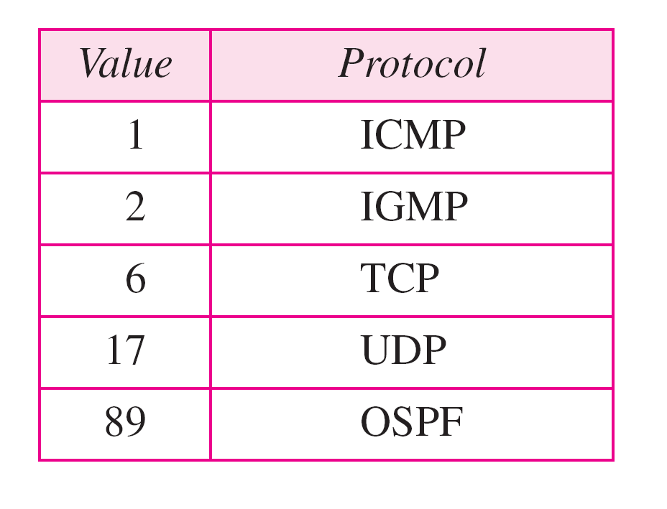
Protocol field and encapsulated data

Slide 26
Fragmentation
A datagram can travel through different networks.
Each router decapsulates the IP datagram from the frame it receives, processes it, and then encapsulates it in another frame.
The format and size of the received frame depend on the protocol used by the physical network through which the frame has just traveled.
The format and size of the sent frame depend on the protocol used by the physical network through which the frame is going to travel.

Slide 27
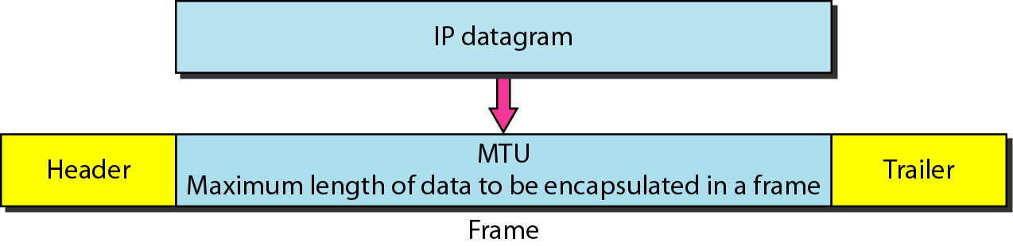
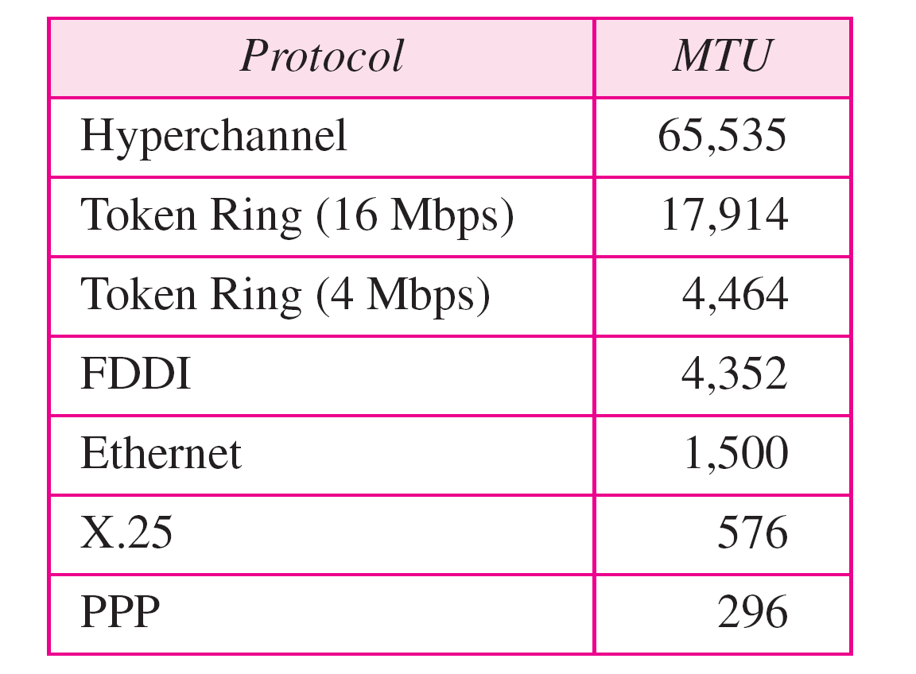
Maximum transfer unit (MTU)
Only data in a datagram is fragmented.

Slide 28
Fields related to fragmentation
Identifier, flags, fragment offset → used primarily for fragmentation
0
4
8
12
16
19
24
28
31
ver-
sion
HLen
TOS
Length
Identifier
Flags
Offset
TTL
Protocol
Checksum
Source Address
Destination Address
Options (if any)
Data

Slide 29

Flags used in fragmentation

Slide 30
Fragmentation Offset
This 13-bit field shows the relative position of this fragment with respect to the whole
0
4
8
12
16
19
24
28
31
ver-
sion
HLen
TOS
Length
Identifier
Flags
Offset
TTL
Protocol
Checksum
Source Address
Destination Address
Options (if any)
Data

Slide 31
Fragmentation and Re-assembly
Different maximum packet sizes for different networks
routers may need to split the datagrams into smaller fragments
When to re-assemble
At destination
Packets get smaller as data travel
inefficiency due to headers
Intermediate reassembly
Need large buffers at routers
All fragments must go through same router
Inhibits dynamic routing

Slide 32
IP Fragmentation
In IP, reassembly is at destination only
Uses fields in header
Data Unit Identifier – In order to uniquely identify datagram – all fragments that belong to a datagram share the same identifier
Source and destination addresses
Upper protocol layer (e.g. TCP)
Identification supplied by that layer
Data length
Length of user data in octets (if fragment, length of fragment data)
Actually header contains total length incl. header but data length can be calculated
Offset
Position of fragment of user data in original datagram (position of the first byte of the fragment)
In multiples of 64 bits (8 octets)
More flag
Indicates that this is not the last fragment (if this flag is 1)

Slide 33
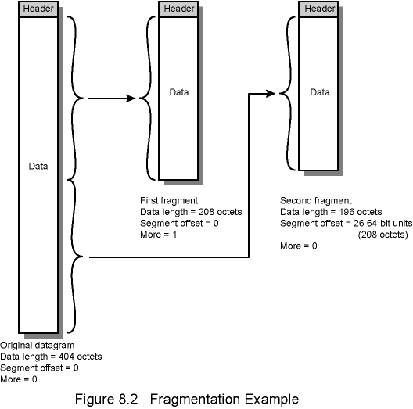
Fragmentation Example

Slide 34
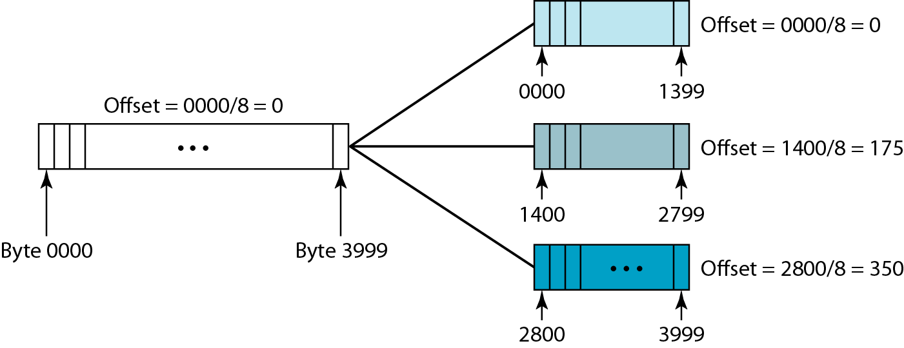
Fragmentation example

Slide 35
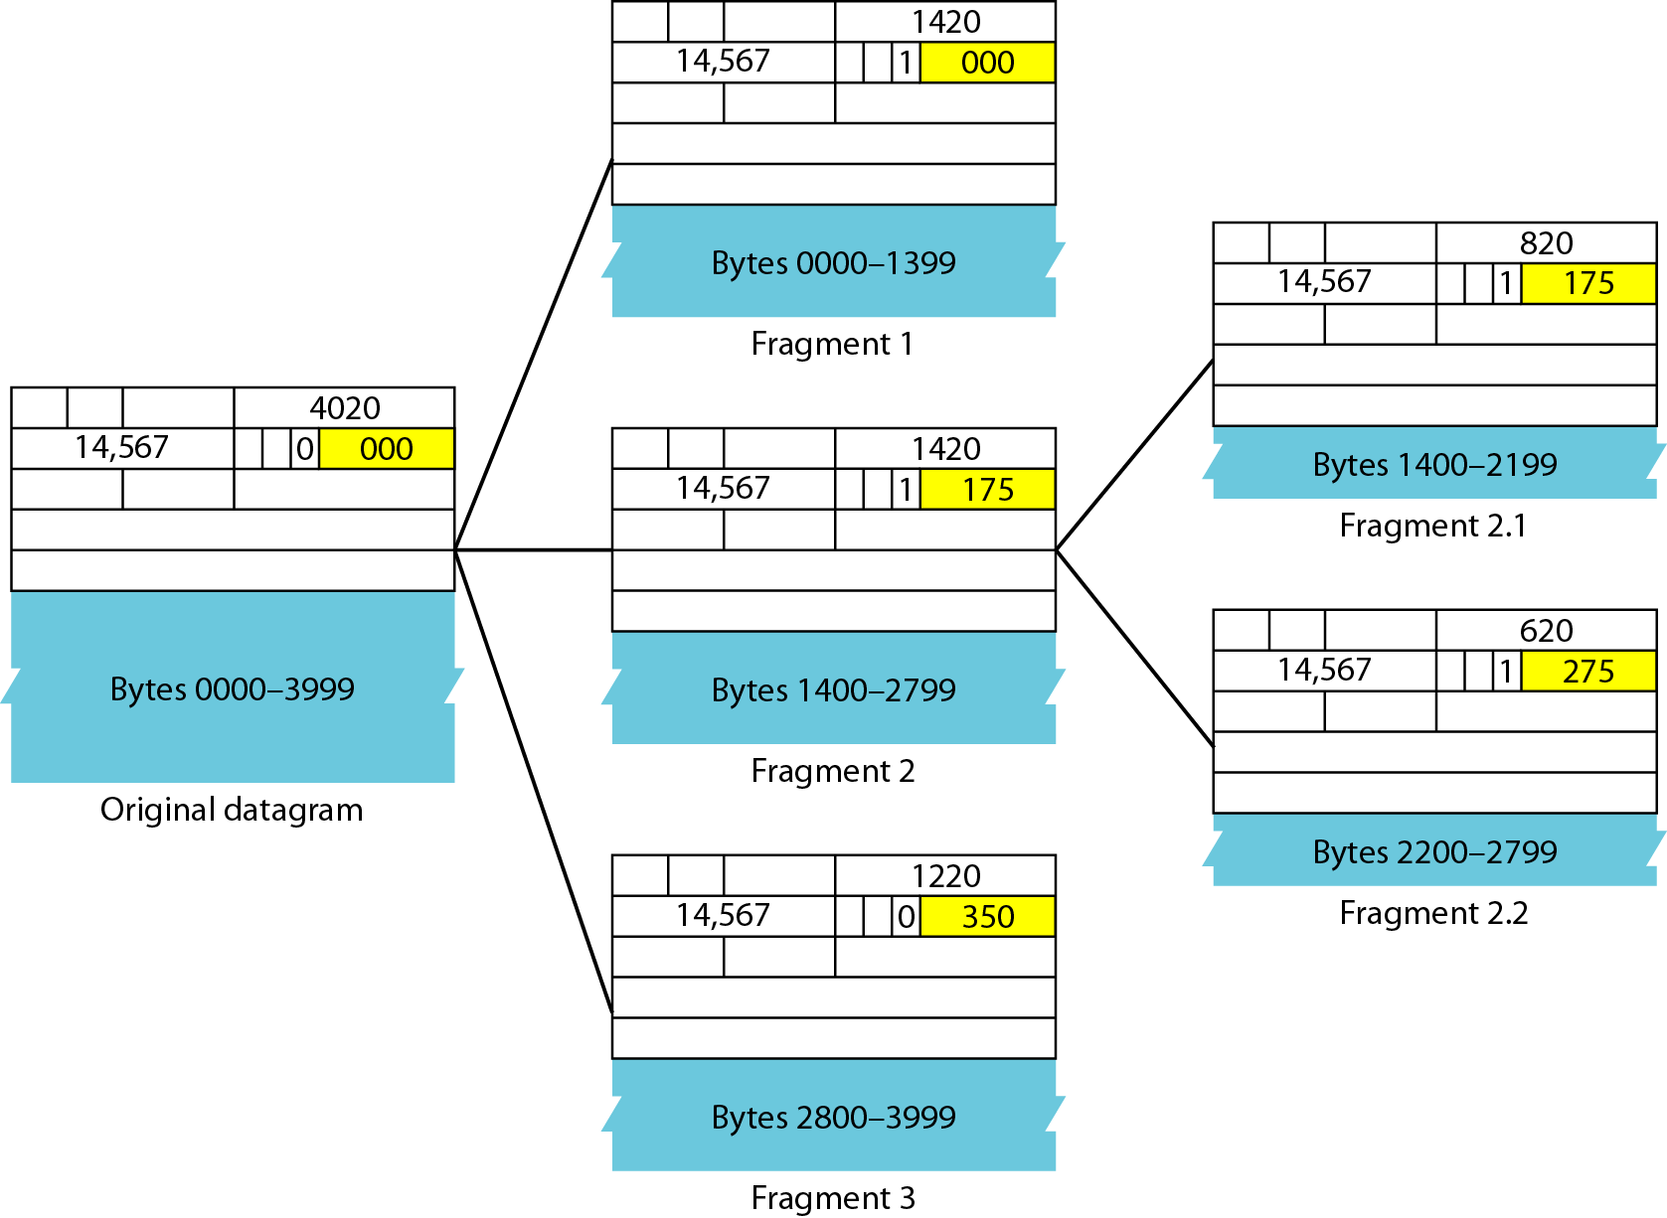
Detailed fragmentation example

Slide 36
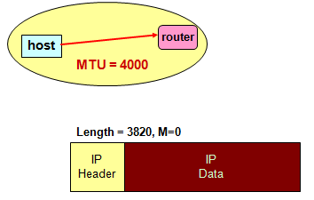
IP Fragmentation Example #1

Slide 37
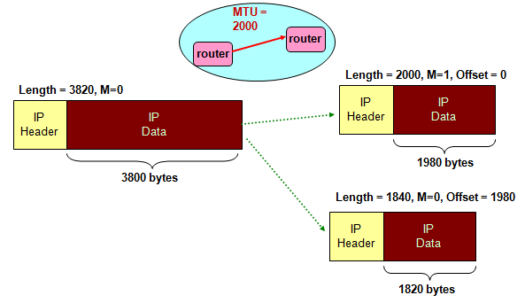
IP Fragmentation Example #2

Slide 38
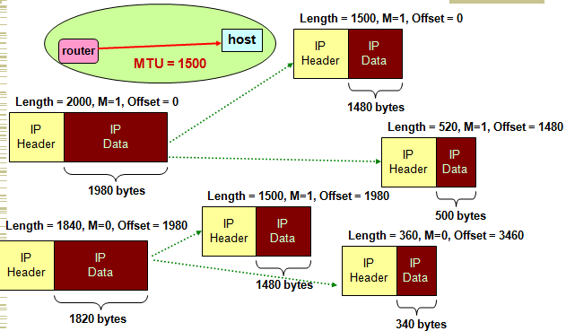
IP Fragmentation Example #3

Slide 39
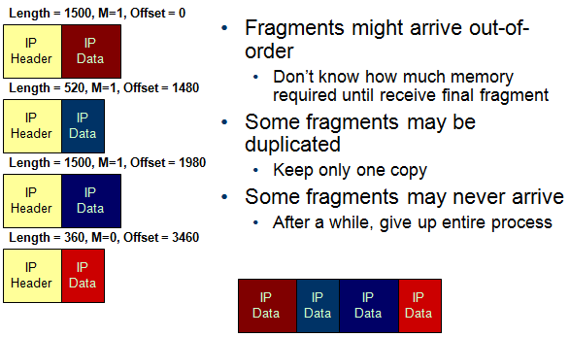
IP Reassembly

Slide 40
Example
A packet has arrived with an M bit value of 0. Is this the first fragment, the last fragment, or a middle fragment? Do we know if the packet was fragmented?
Solution
If the M bit is 0, it means that there are no more fragments; the fragment is the last one. However, we cannot say if the original packet was fragmented or not. A nonfragmented packet is considered the last fragment.

Slide 41
Example
A packet has arrived with an M bit value of 1. Is this the first fragment, the last fragment, or a middle fragment? Do we know if the packet was fragmented?
Solution
If the M bit is 1, it means that there is at least one more fragment. This fragment can be the first one or a middle one, but not the last one. We don’t know if it is the first one or a middle one; we need more information (the value of the fragmentation offset). See also the next example.

Slide 42
Example
A packet has arrived with an M bit value of 1 and a fragmentation offset value of zero. Is this the first fragment, the last fragment, or a middle fragment?
Solution
Because the M bit is 1, it is either the first fragment or a middle one. Because the offset value is 0, it is the first fragment.

Slide 43
Example
A packet has arrived in which the offset value is 100. What is the number of the first byte? Do we know the number of the last byte?
Solution
To find the number of the first byte, we multiply the offset value by 8. This means that the first byte number is 800. We cannot determine the number of the last byte unless we know the length of the data.

Slide 44
Example
A packet has arrived in which the offset value is 100, the value of HLEN is 5 and the value of the total length field is 100. What is the number of the first byte and the last byte?
Solution
The first byte number is 100 × 8 = 800. The total length is 100 bytes and the header length is 20 bytes (5 × 4), which means that there are 80 bytes in this datagram. If the first byte number is 800, the last byte number must be 879.

Slide 45
Checksum
0
4
8
12
16
19
24
28
31
ver-
sion
HLen
TOS
Length
Identifier
Flags
Offset
TTL
Protocol
Checksum
Source Address
Destination Address
Options (if any)
Data

Slide 46
Checksum
The error detection method used by most TCP/IP protocols is called the checksum.
The checksum protects against the corruption that may occur during the transmission of a packet. It is redundant information added to the packet.
The checksum is calculated at the sender and the value obtained is sent with the packet.
The receiver repeats the same calculation on the whole packet including the checksum.
If the result is satisfactory, the packet is accepted; otherwise, it is rejected.

Slide 47
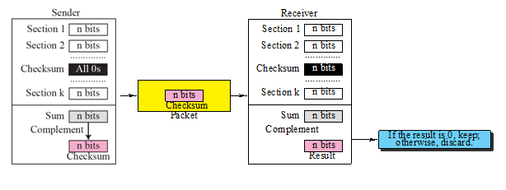

Checksum in one’s complement arithmetic

Slide 48
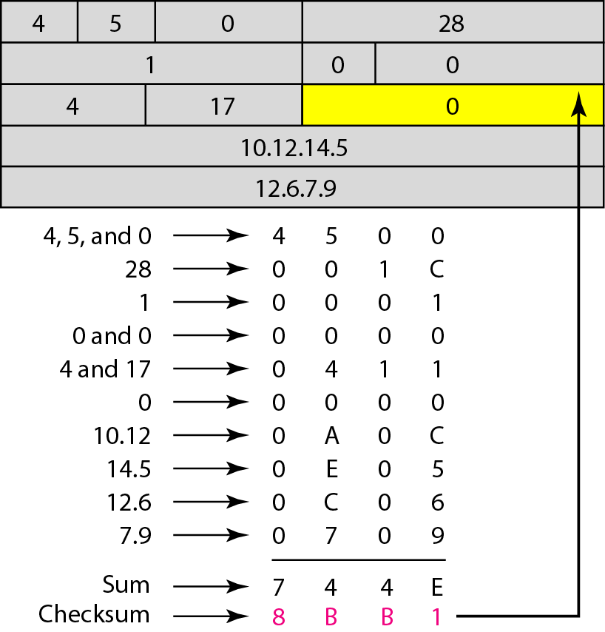
Checksum
Checksum in IP covers only the header, not the data.
The header is divided into 16-bit sections. All the sections are added and the sum is complemented. The result is inserted in the checksum field.

Slide 49
Options
The header of the IP datagram is made of two parts: a fixed part and a variable part. The fixed part is 20 bytes long and was discussed in the previous section. The variable part comprises the options, which can be a maximum of 40 bytes.
Options, as the name implies, are not required for a datagram. They can be used for network testing and debugging. Although options are not a required part of the IP header, option processing is required of the IP software.

Slide 50
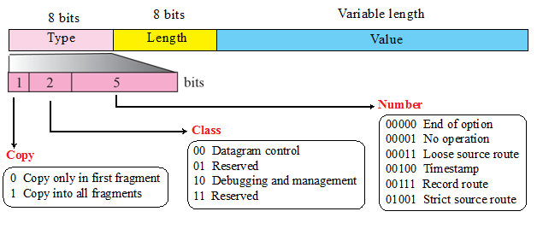
Option format

Slide 51
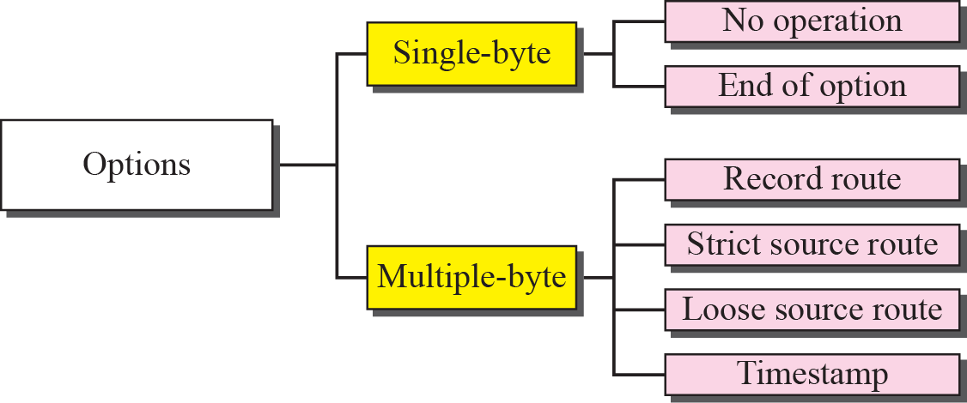
Categories of options

Slide 52
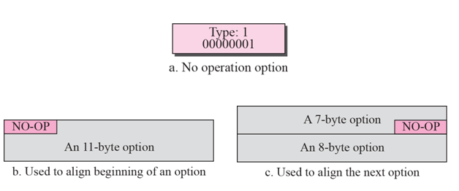
No operation option

Slide 53
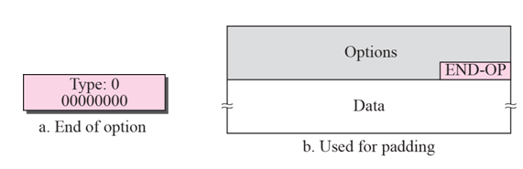
End-of-option option

Slide 54
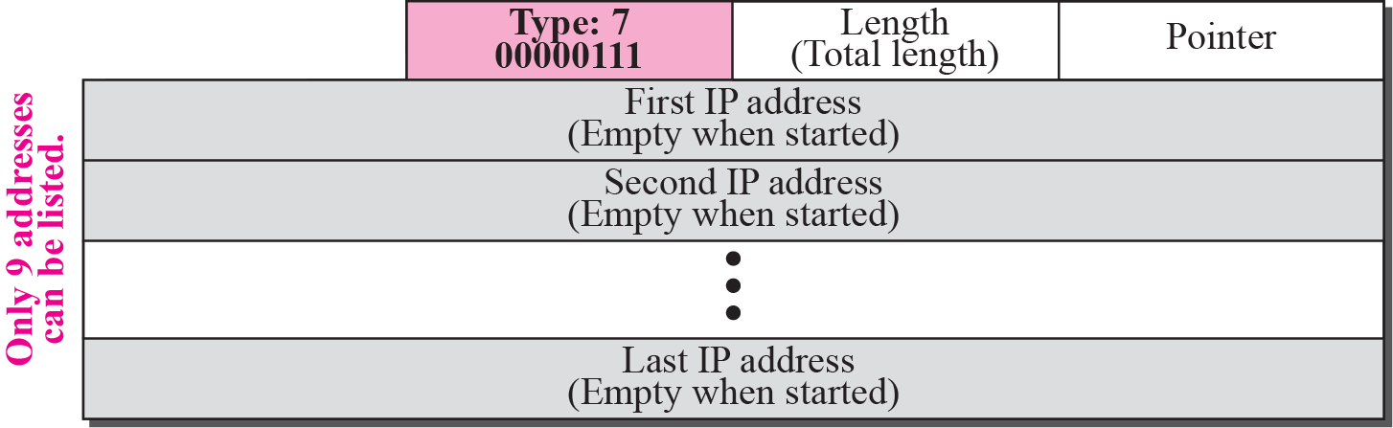
Record-route option

Slide 55
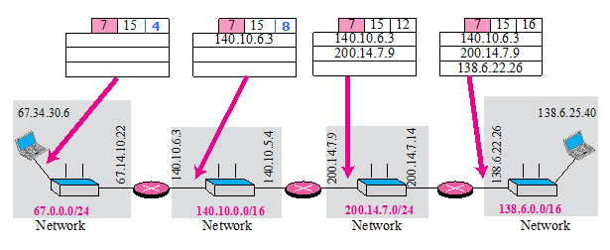
Record-route concept

Slide 56
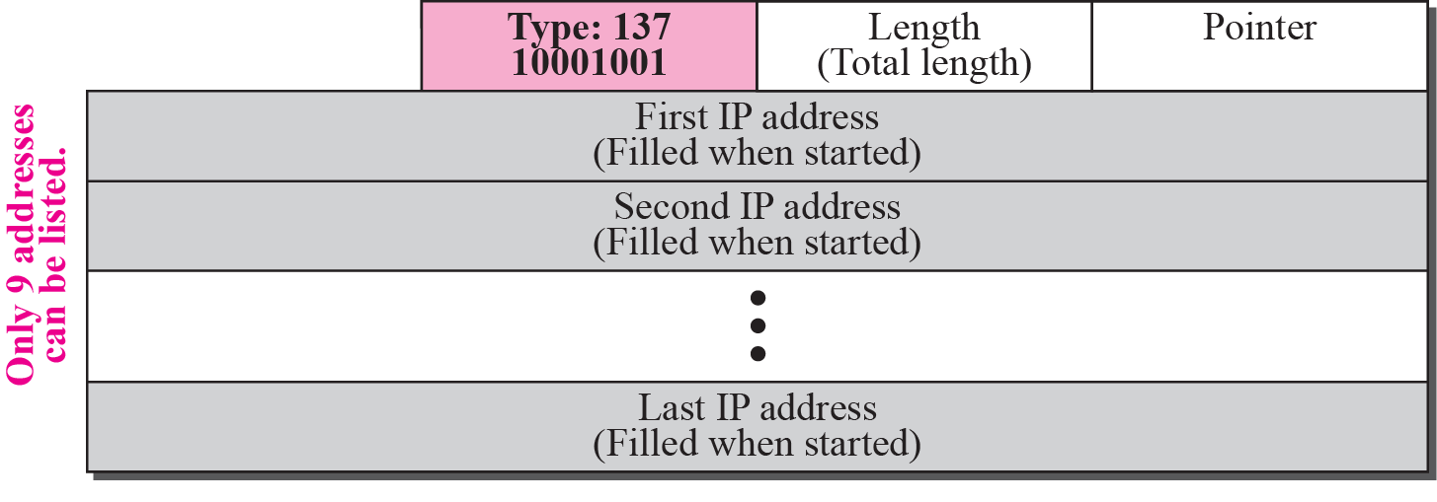
Strict-source-route option

Slide 57
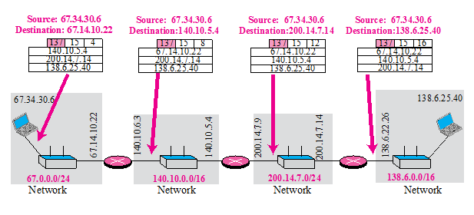
Strict-source-route option

Slide 58
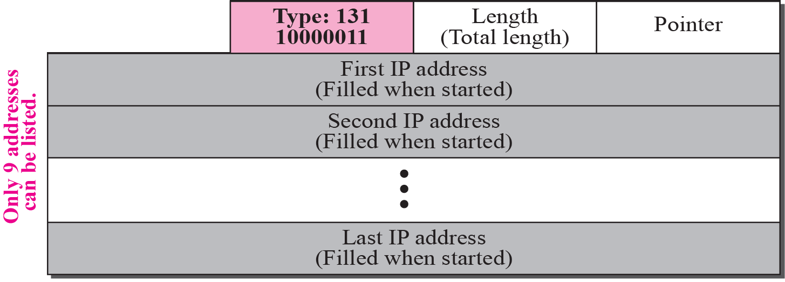
Loose-source-route option

Slide 59
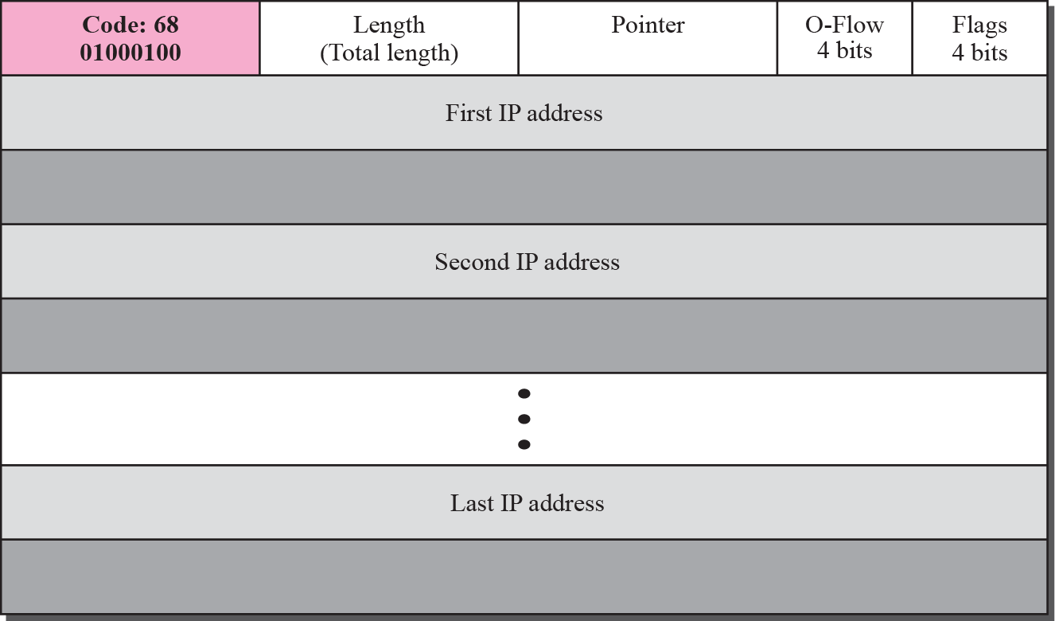
Time-stamp option

Slide 60
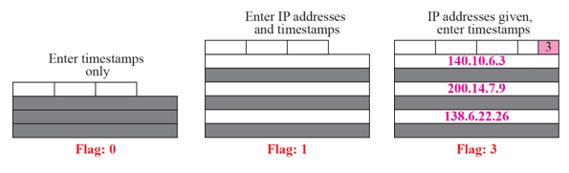
Use of flags in timestamp

Slide 61
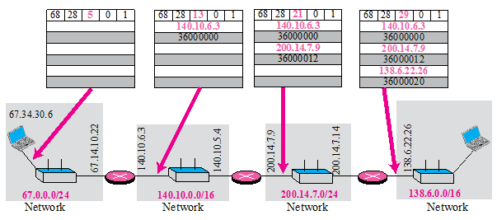
Timestamp concept

Slide 62
ping and traceroute
One of the utilities available in UNIX to check the traveling of the IP packets is ping.
We can also use the ping utility with the -R option to implement the record route option.
The traceroute utility can also be used to keep track of the route of a packet.
The traceroute program can be used to implement loose source routing. The -g option allows us to define the routers to be visited, from the source to destination.

Slide 63
IPv4 to IPv6
The network layer protocol in the TCP/IP protocol suite is currently IPv4.
Although IPv4 is well designed, data communication has evolved since the inception of IPv4 in the 1970s.
IPv4 has some deficiencies that make it unsuitable for the fast-growing Internet.

Slide 64
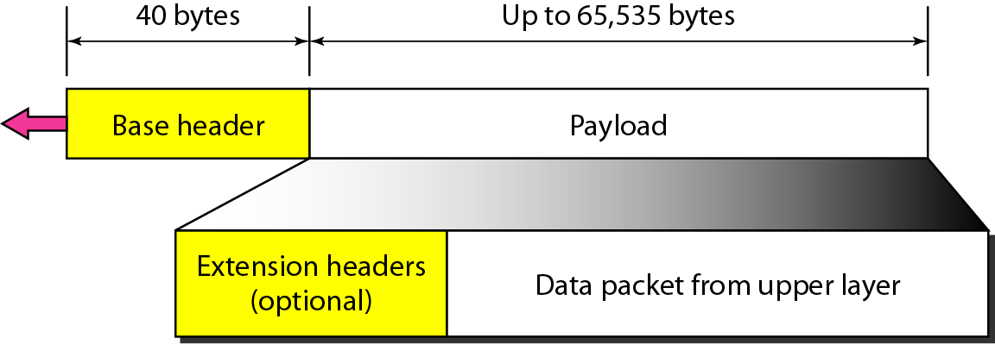
IPv6 datagram header and payload

Slide 65
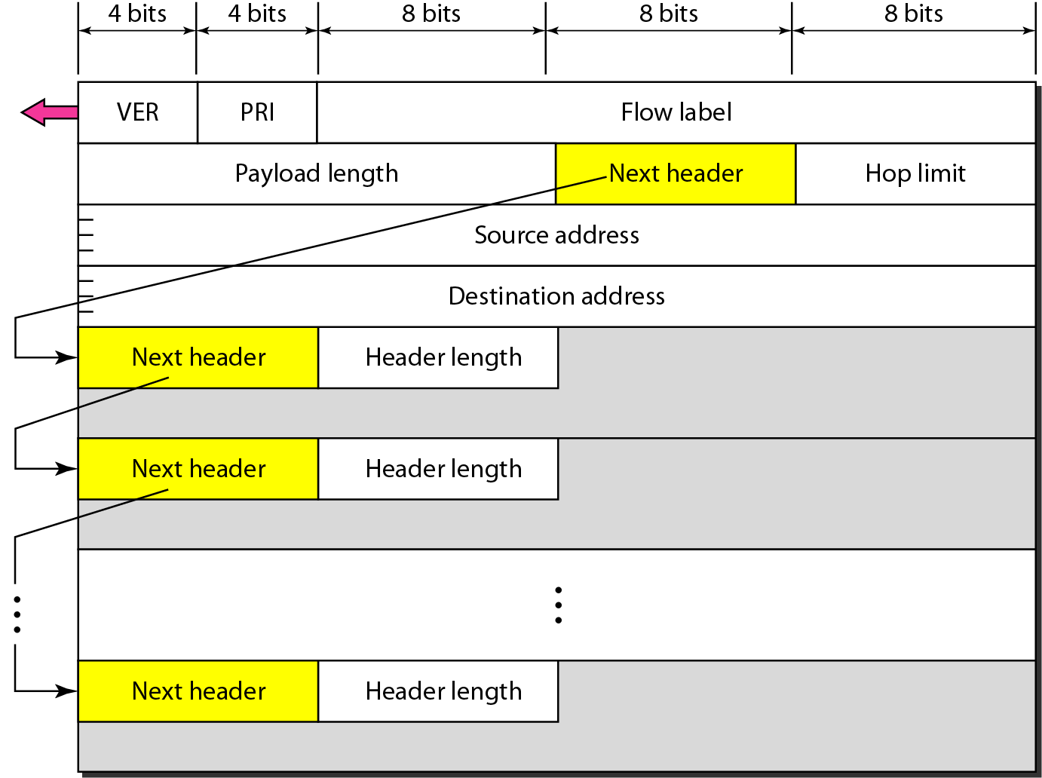
Format of an IPv6 datagram

Slide 66
Next header codes for IPv6

Slide 67
Priorities for congestion-controlled traffic

Slide 68
Priorities for noncongestion-controlled traffic

Slide 69
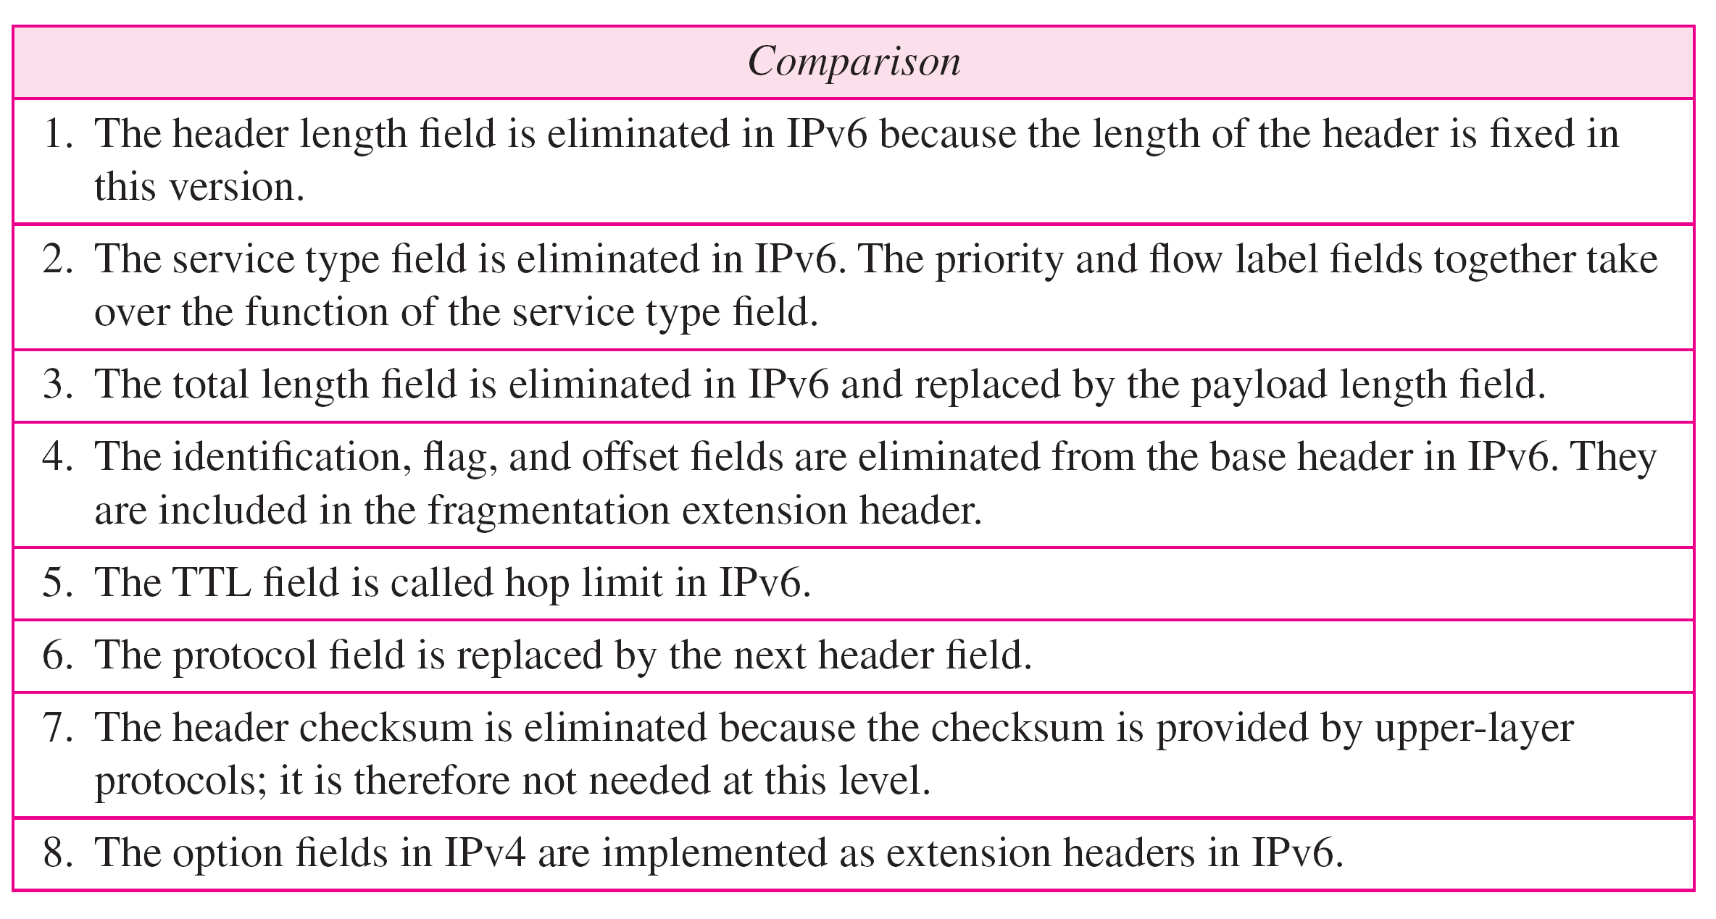
Comparison between IPv4 and IPv6 packet headers

Slide 70
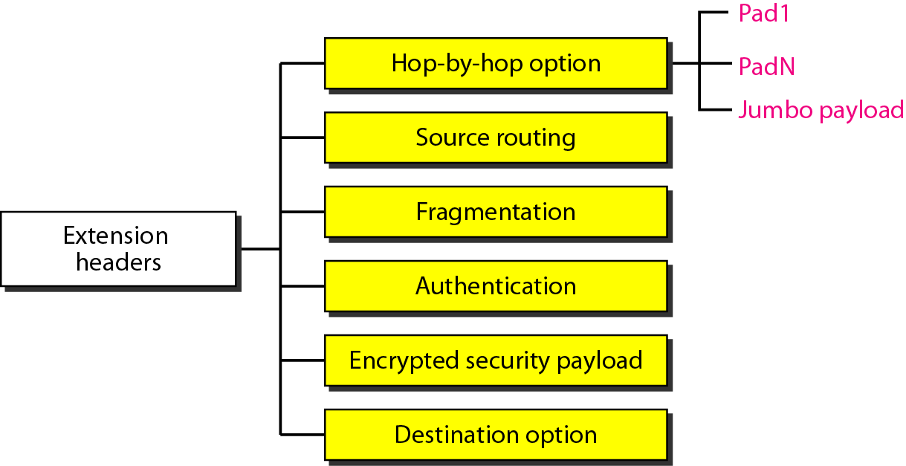
Extension header types

Slide 71
Comparison between IPv4 options and IPv6 extension headers

Slide 72
Transition from IPv4 to IPv6
Because of the huge number of systems on the Internet, the transition from IPv4 to IPv6 cannot happen suddenly.
It takes a considerable amount of time before every system in the Internet can move from IPv4 to IPv6.
The transition must be smooth to prevent any problems between IPv4 and IPv6 systems.

Slide 73
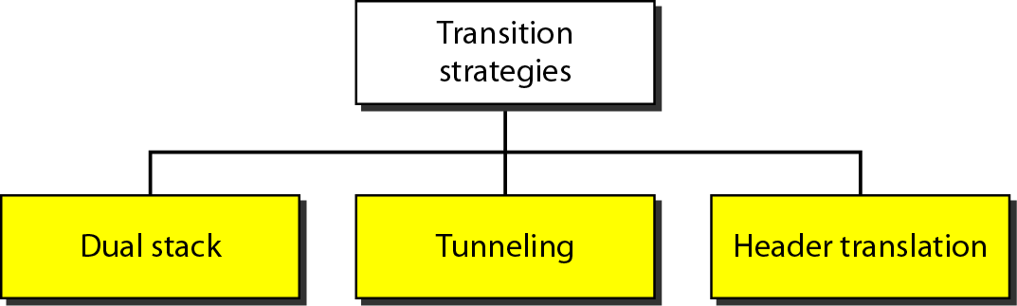
Three transition strategies

Slide 74
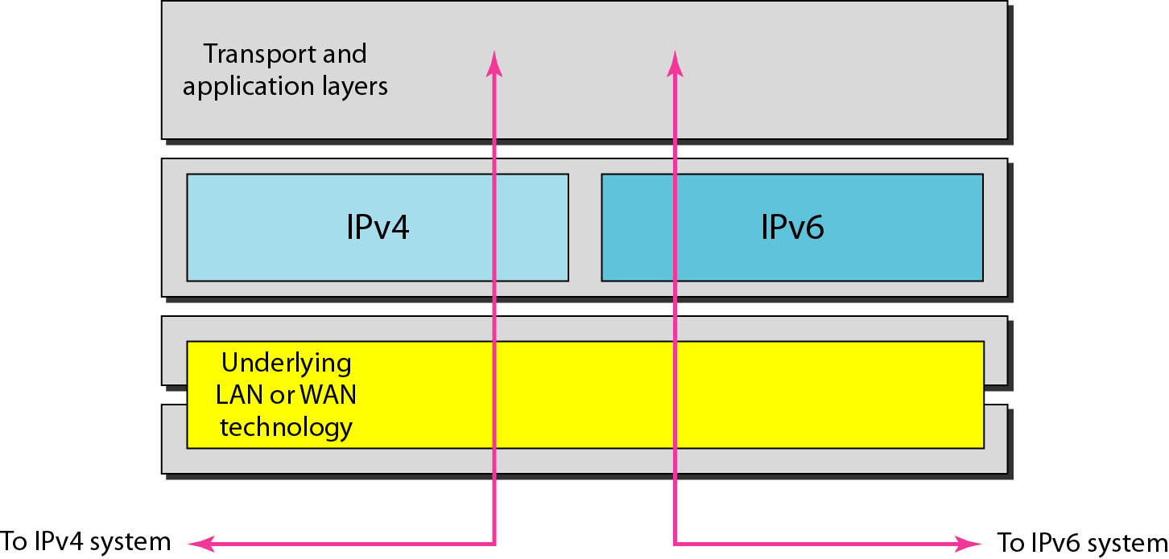
Dual stack

Slide 75
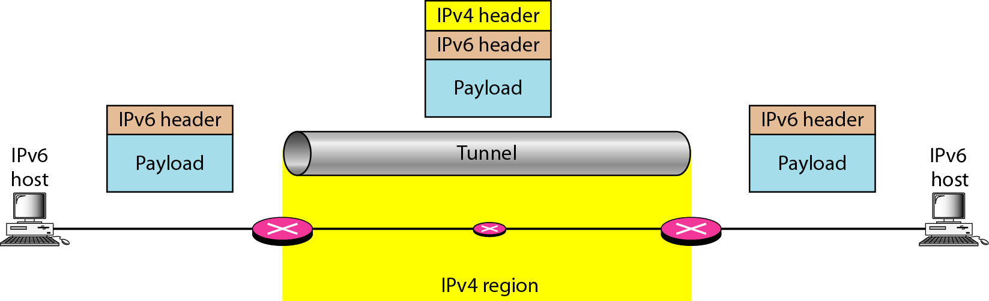
Tunneling strategy

Slide 76
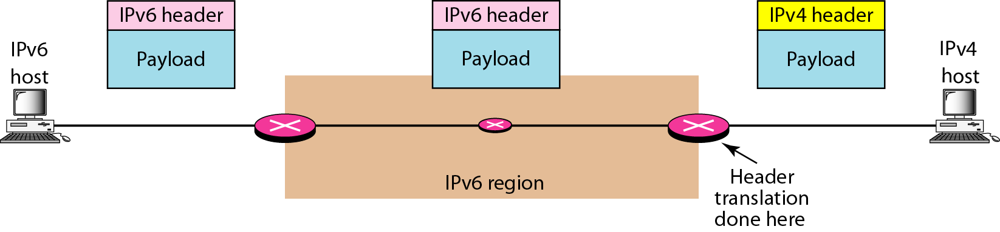
Header translation strategy

Slide 77
Header translation

